Slide 1


Introducing Buy Hive: Your New E-commerce Destination
Welcome to Buy Hive, a cutting-edge e-commerce platform offering an extensive range of products, from electronics to fashion. Our website boasts a sleek and intuitive design, ensuring a seamless browsing and purchasing experience.

Slide 2
Buy Hive: A Diverse Product Portfolio
Electronics
Clothing & Accessories
Discover a wide selection of electronics, including laptops, smartphones, gaming consoles, and accessories.
Browse through a curated collection of casual wear, outerwear, and stylish accessories for every occasion.
Home & Kitchen
Beauty & Personal Care
Find everything you need to enhance your living space, from furniture and decor to kitchen appliances and cookware.
Explore a range of beauty products, skincare essentials, and personal care items for men and women.

Slide 3
Buy Hive vs. The Competition
Buy Hive
Amazon, Flipkart & Myntra
Buy Hive provides a personalized shopping experience with competitive prices, a seamless user interface, and a secure payment gateway, no extra subscription to have benefits for specified customer.
Amazon boosts a vast product catalog but a lot of benefits are given to Prime users.
Flipkart is usually deemed to not provide a very user-friendly service, whether it’s replacement or return back.
Myntra only focuses on Indian brands, not including any other items.

Slide 4
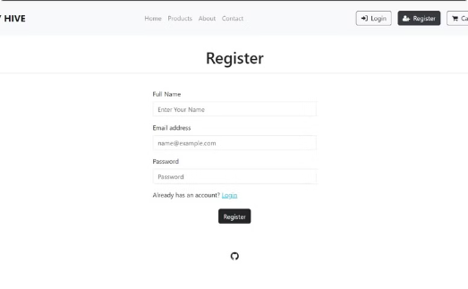
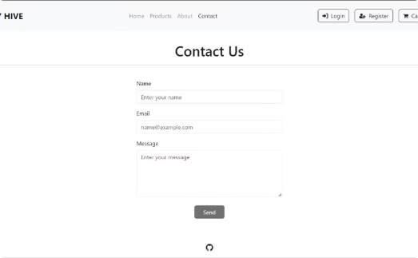
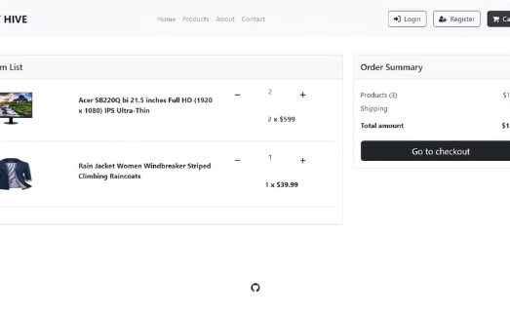
A User-Centric Approach
Simple Login & Registration
Easy Contact Us
Intuitive Shopping Cart
Effortless account creation and secure login for a personalized shopping experience.
Quick and convenient access to customer support through multiple channels.
A straightforward cart system that allows customers to easily manage their purchases.

Slide 5



Features That Enhance the Shopping Experience
Comprehensive Product Descriptions
Fast & Reliable Shipping
High-Quality Product Images
Detailed product descriptions provide all the necessary information to make informed purchasing decisions.
Quick delivery options and reliable shipping services enhance the customer experience.
Detailed and high-resolution product images allow customers to visualize the product before purchase.

Slide 6

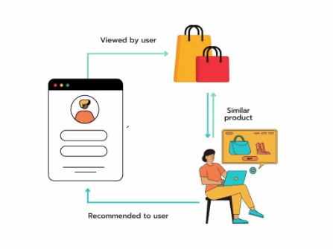



Looking Ahead: Buy Hive's Future
Enhanced Recommendation Engine
Leveraging machine learning to provide personalized product
suggestions based on browsing and purchase history.
Advanced Inventory Management
Improving backend inventory management for better stock monitoring
and reduced out-of-stock situations.
Improved Search Functionality
Enhancing the search algorithm for more accurate and relevant search
results.
Integration with Multiple Payment Gateways
Adding more payment options, including digital wallets and
cryptocurrencies, for greater customer flexibility.

Slide 7
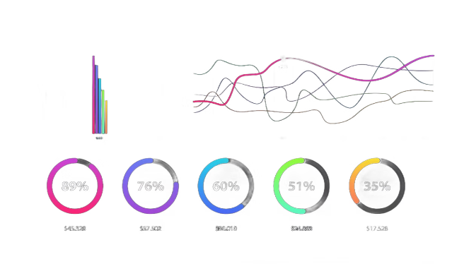
Buy Hive: A Platform Built for Growth
Scalability
Our platform is designed to handle increasing traffic and product volume as we expand our offerings.
Innovation
We continuously invest in research and development to improve our platform and deliver the best possible shopping experience.
Customer Focus
Customer satisfaction is our top priority. We strive to provide a seamless, secure, and enjoyable online shopping experience.

Slide 8


